Slide 1
COMP2432 Project
Appointment Organizer
Group 5 Members
DENG Chun Yung (21084115D)
JIANG Guanlin (21093962D)
LI Tong (21101988D)
LIU Yuzhou (21100602D)
NIYITEGEKA Berwa Aime Noel (21104645D)

Slide 2
INDEX
Project Self-Evaluation
Advantages
Disadvantage and Future development
Goal
Project Objectives
Flowchart
Design details
Major entities
Major functions

Slide 3
Goal (the objective)
Project Objectives
Implementing APO (APpointment Organizer) with pipe( ) and fork( )
Based on Linux C
Multiple modes (FCFS, PRIORITY)
Helps users organize and manage their time

Slide 4
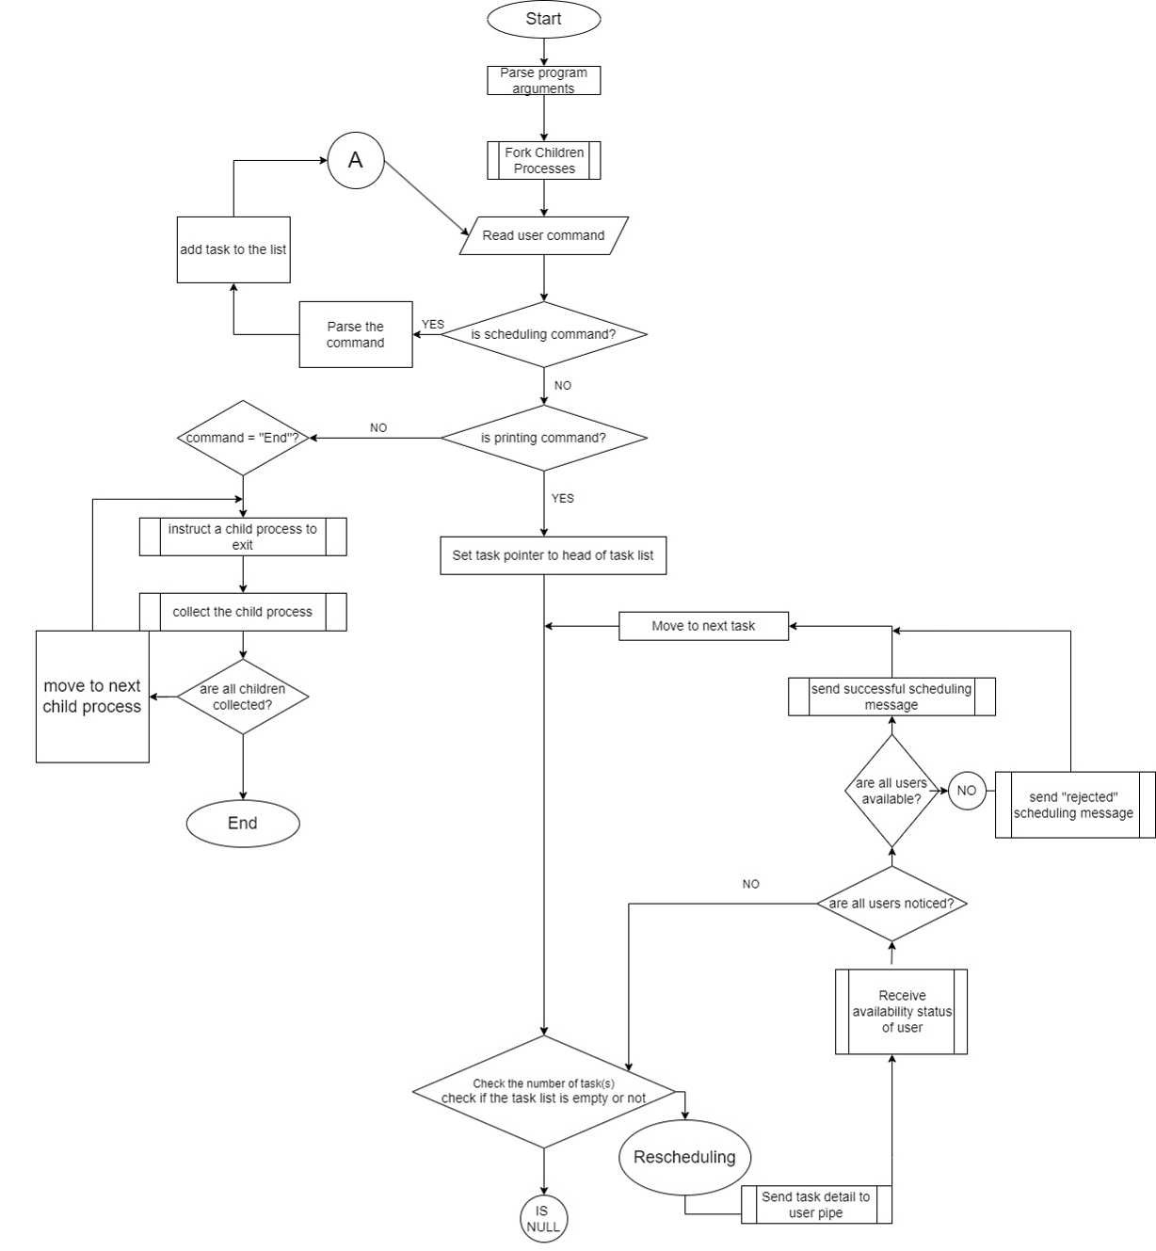
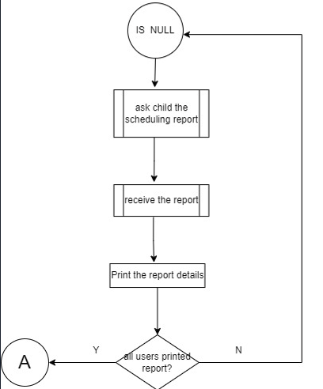
SYSTEM FLOWCHART

Slide 5
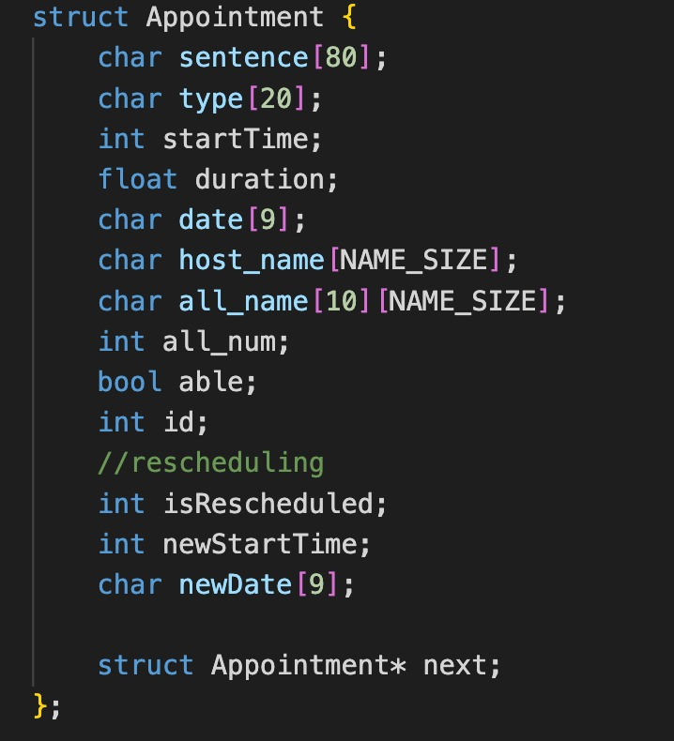
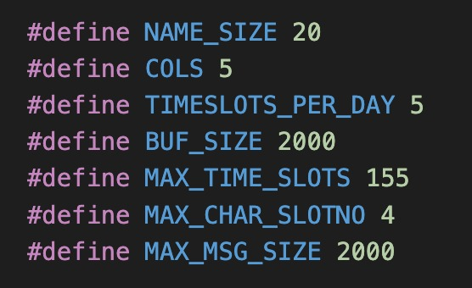
SYSTEM DESIGN - MAJOR ENTITIES
Struct Appointment
2D Arrays
Basic Data Definition

Slide 6
SYSTEM DESIGN - MAJOR FUNCTIONS
Logic functions
Locate functions
Reinitialization
Node creation
Node insert
Schedule Timetable
File write in

Slide 7
SYSTEM EVALUATION
Well structured
Well Code Encapsulation
Time efficiency
The use of Link list and 2d array
Readability
Well-annotated
Clear variable name
STRENGTH

Slide 8
SYSTEM EVALUATION
Code duplication
Scalability
Too many code in main function
Memory Efficiency
2D array — space consuming
FLAWS AND FUTURE DEVELOPMENT

